Slide 1
Javascript Frameworks using Angular
What is Angular
Angular Concepts
Installing Angular
Project Structure
Templates
Data binding
Running Application
CSS Framework - Bootstrap

Slide 2
What is Angular
Angular is a frontend MVC (model view controller) framework, developed by Google
Angular has had two major versions:
AngularJS 1.x
Angular 2…
Angular originally was designed to work with JavaScript, hence the name ‘AngularJS’
Version two was a radical rewrite which now uses TypeScript
Since Angular is now based on TypeScript, ‘JS’ has been removed from the Name
The current stable version of Angular is version 8.x (May 2019)

Slide 3
What is Angular
Angular being a front end framework does not run on a server however it can communicate with servers to access data.
Angular apps compile to javascript files which are loaded into the browser and run locally as a single paged website. The index.html page is the single parent html document used to display an angular application. There is no navigating to another HTML only changing what DOM elements exist on the current page.
Angular is designed to provide a better structure to larger Javascript projects.

Slide 4
Angular Concepts
Angular presents 6 main concepts to front-end development:
Modules
Components
Templates
Data Binding
Services
Directives

Slide 5
Modules
Angular apps are modular and use a modularity system called NgModules.
NgModules are containers that group together blocks of functionality that belong together. This can include components, directives, services etc.
NgModules can import functionality that is exported from another NgModule and export functionality for use by other modules. (Think of module.exports and require used by javascript in nodeJS)
The first module we will deal with is the AppModule which represents the entire application.

Slide 6
Components
Components control a patch of screen called a view. The components application logic is defined inside a class. The class interacts with the view through an API of properties and methods.
A component performs the following tasks:
○ Creates and displays HTML and CSS for the component
○ Handles any events that occur within the component
○ Manages any data that might be displayed or entered into the component

Slide 7
Templates
Templates are HTML files that define how a view for a component is rendered.

Slide 8
Data Binding
Data binding is the process that connects a component to its template and allows data and events to flow between them.
In MVC terms it is the synchronization between the model (data) and the view

Slide 9
Services
Services provide re-useable functionalities that are independent of the views
Components should not fetch or save data directly.
The job of fetching and saving data should be delegated to a service. As it is independent of the view it can be reused any where in the app that the data should be communicated.

Slide 10
Directives
There are three kinds of directives
Components – Directive with a template
Structural Directives – change the DOM layout be adding and removing DOM elements
Attribute directives – change the appearance or behaviour of an element, component or other directive.

Slide 11
Installing Angular
Node must be installed prior to installing Angular.
We will be using the Node Package Manager to install the Angular CLI (Command line interface)
npm install –g @angular/cli
This can be run from any directory and will install a global instance of the angular CLI . With this installed we have a tool that can create a new angular application in any directory on the computer.
The angular CLI provides us with a tool to help with auto generating the files and file structure of an angular application.

Slide 12
Creating a New Project
Using the Angular CLI we can create a new project
Create a directory for your application and, in a terminal window change to that directory using the cd (change directory) command, then type:
ng new my-app
ng is the executable for an angular command. A range of commands can be passed to this executable. Checkout the Angular CLI documentation for all of the options.
The “new” command will tell ng to generate all of the files required for a new default angular application and “my-app” is the name of the directory it will create to place the files it creates. This may take a little while as all of the require NPM packages are downloaded.

Slide 13
Creating a New Project
You may be asked a series of questions in the terminal once you enter: ng new my-app to create a new application
You will be asked if you would like to add Angular Routing. No is the default but say Yes, we will discuss routing later.
You will be asked what format of stylesheet you would like to use. You have a choice of css, scss, sass, less or stylus. Pick which CSS pre-processor will be used. The choice is yours. CSS is the default.

Slide 14
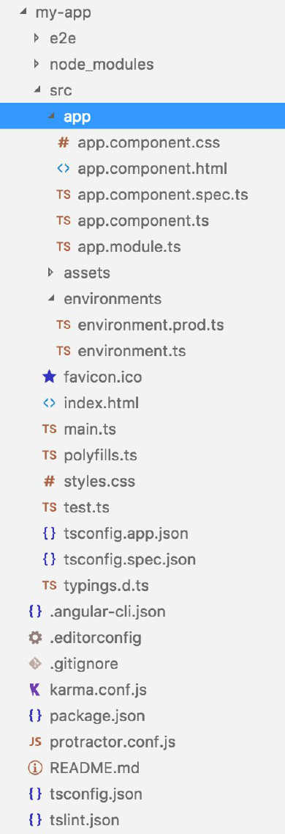
Project Structure
Like most frameworks Angular generates a lot of files
The main files we are interested in are in src/app directory
Other files of interest are src/index.html and src/main.ts, and package.json
At this stage you can safely ignore the other files

Slide 15
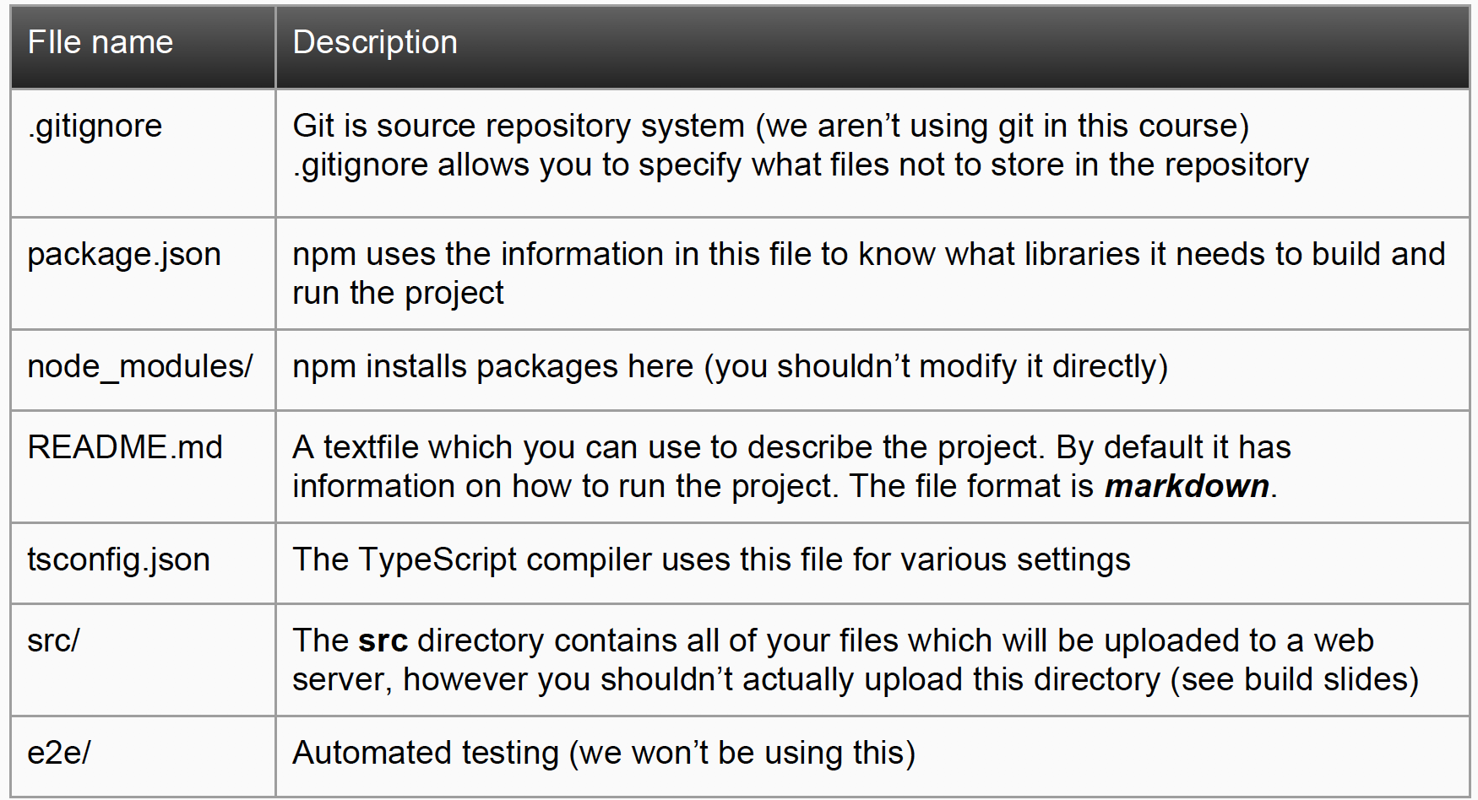
File Descriptions

Slide 16
main.ts file
main.ts is the main TypeScript file, all other files are loaded through
main.ts
The main.ts file defines which of the angular module files will be bootstrapped as the root module or entry component
Inserting a boostrapped component usually triggers a cascade of component creation that fills out the tree of components that make up the application.

Slide 17
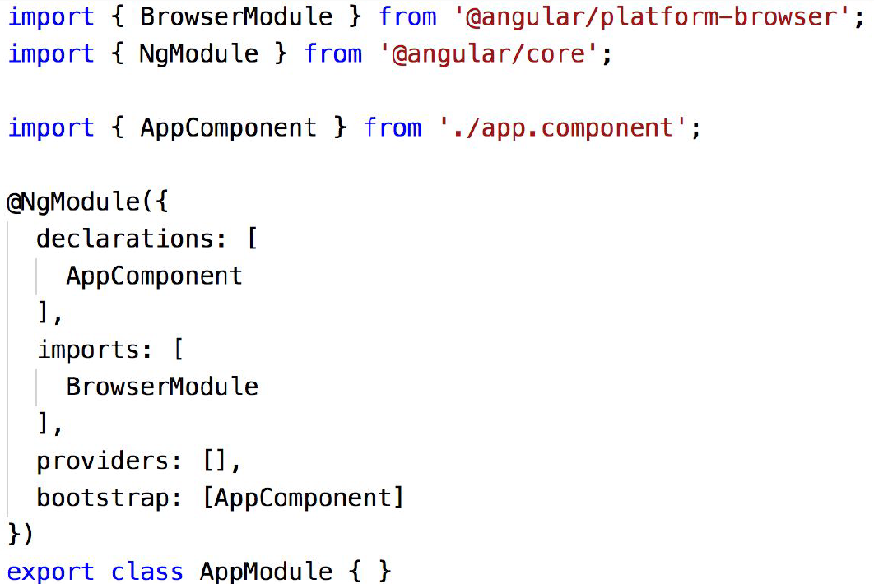
AppModule
The AppModule is defined in the file src/app/app.module.ts
Note that it imports AppComponent from ./app.component
Decorator

Slide 18
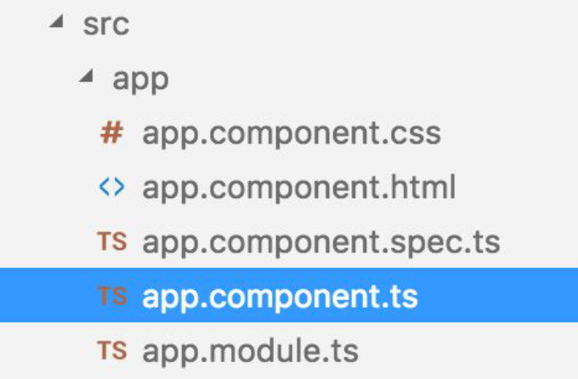
Components
You can see that there are 4 files beginning with app.component.*
All of these files are related to the component
app.component.ts
○ The TypeScript file containing the code for the component
app.component.html
○ This represents the html for the component
○ This file is optional and included in app.component.ts
app.component.css
○ CSS style sheet for the component
○ It is optional and included in app.component.ts
app.component.spec.ts
○ Used for testing, not used in this course

Slide 19
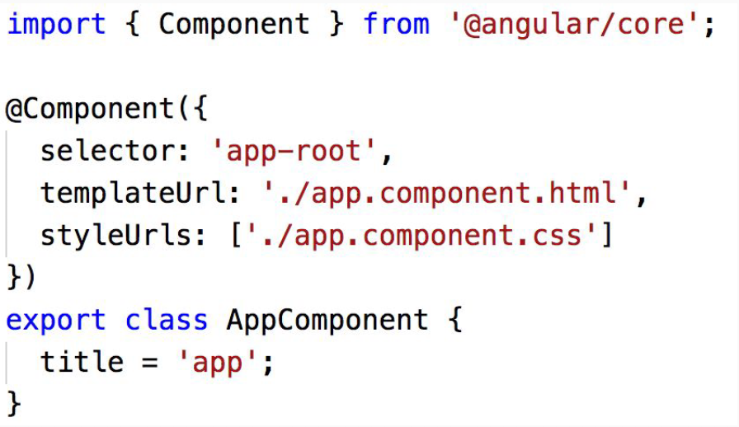
AppComponent
The initial AppComponent is simple:
selector – HTML tag used to add this component to a page.
templateURL – HTML to be displayed in the component
styleURLs – CSS to style the component
Component Decorator
HTML Tag for the component
defines where to find the html for the component
Array defines where to find the css files for the component

Slide 20
Component Selector
Each component has a selector
This effectively means that you are defining your own HTML tag for the component
Take the following HTML as an example
None of these tags are part of HTML however as long as we define
Angular components with these selectors, Angular will replace them with
their respective components (and HTML templates):
<menu></menu>
<navBar></navBar>
<signUpForm></signUpForm>

Slide 21
Index.html
The AppComponent selector is “app-root”:
This means that it will be placed
anywhere there is the <app-root> tag,
such as index.html:
<!DOCTYPE html>
<html lang="en">
<head>
<meta charset="utf-8" />
<title>My App</title>
<base href="/" />
<meta name="viewport" content=“width=device-width, initial-scale=1” />
<link rel="icon" type="image/png" href="assets/icon/favicon.png" />
</head>
<body>
<app-root></app-root>
</body>
</html>

Slide 22
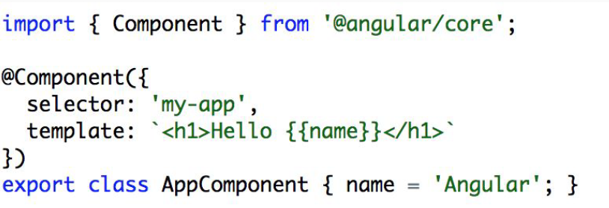
Templates
Templates contain HTML which forms the ‘view’ of the component
The template doesn’t have to be a separate HTML file. The HTML can be included directly in a string, making a very compact component declaration:
● The AppComponent class defines a property name with the initial value ‘Angular’
● The name is then used in the template with {{name}}, this inserts the value of name directly in the HTML

Slide 23
Data Binding
We displayed the value of "name" in the template using Data Binding Interpolation
Data binding is a fundamental technique of modern web development
Data binding creates a dynamic connection between the HTML and the
data that it was bound to, if the data’s value changes, the HTML will
be automatically updated, without needing to write any code to perform the update.
In the template, properties are surround by double curly braces to denote one way data binding. (If the data changes in the class it will be reflected in the template.)

Slide 24
Building an Angular Project
Angular’s purpose is to make building larger websites more manageable
● As a result the contents of the src directory are not in optimal form to
distribute to a large audience
● We should build the contents of the src directory into a more compact
representation ready for distribution
● You will need to change into the "my-app" directory and run ng build:
cd my-app
ng build

Slide 25
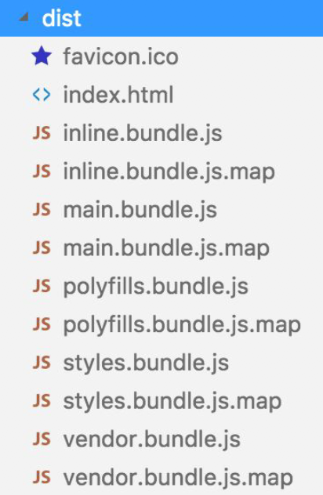
The “dist” Directory
ng build will create a dist directory (short for distribution) and it will contain all the code for a fully function Angular website
It is the code in the dist directory that you will upload to your web server for use.
Note that it has the index.html and several JavaScript files (compiled from TypeScript)
The *.map files are not necessary to run the app but are used when debugging

Slide 26
Running an Angular Application
A built app must be served
When developing it can be a slow process to build, upload, and the reload
the webpage
Angular has a convenience option called: ng serve
It starts its own web server and will rebuild files as soon as a saved change is detected.
If you add the --open option it will also attempt to open and load in the browser
ng serve --open

Slide 27
Adding a CSS Framework
A CSS framework allows us to easily create standards compliant web pages using the Cascading Style Sheets language
There are a number of frameworks available. We will be using a framework first developed by Twitter in Mid 2010 called Bootstrap.
To add bootstrap to a project we first need to add the bootstrap node module to our application. In a terminal window navigate to the directory of your application e.g. my-app.
type: npm install bootstrap –save

Slide 28
Adding a CSS Framework - Bootstrap
The bootstrap module will be downloaded and a entry will be added to the package.json file so that it knows that our app depends on bootstrap.
We now have to update the angular.json file. This file hold configuration information about the application.
Update the "styles" array in the json file and add the bootstrap css file.
e.g. "styles": [
"node/modules/bootstrap/dist/css/bootstrap.min.css",
"src/styles.css"
]
You can now use bootstrap class's in your application

Slide 29
Summary
Angular is a large framework, don’t be worried if you feel overwhelmed
We haven’t explained some of the new syntax, however it isn’t necessary to
get started to build projects
In this week’s lab you will follow a tutorial to build an Angular web page

Slide 30
Command Summary
Install Angular CLI
npm install –g @angular/cli
Serve New App
ng serve --open
Create New App
ng new my-app
Build New App
ng build

